Slide 1
War and Independence
Part 6
Common Sense

Slide 2
Think About It
How can you convince someone to do something or think a certain way?

Slide 3
When the Revolutionary War started, a majority of the population in the colonies didn’t want to fight a war or even wanted independence and break away from Great Britain.
So how did it happen? What made so many people change their mind?

Slide 4
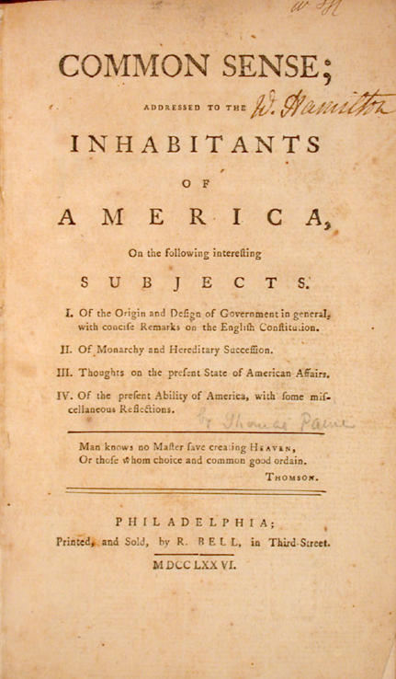
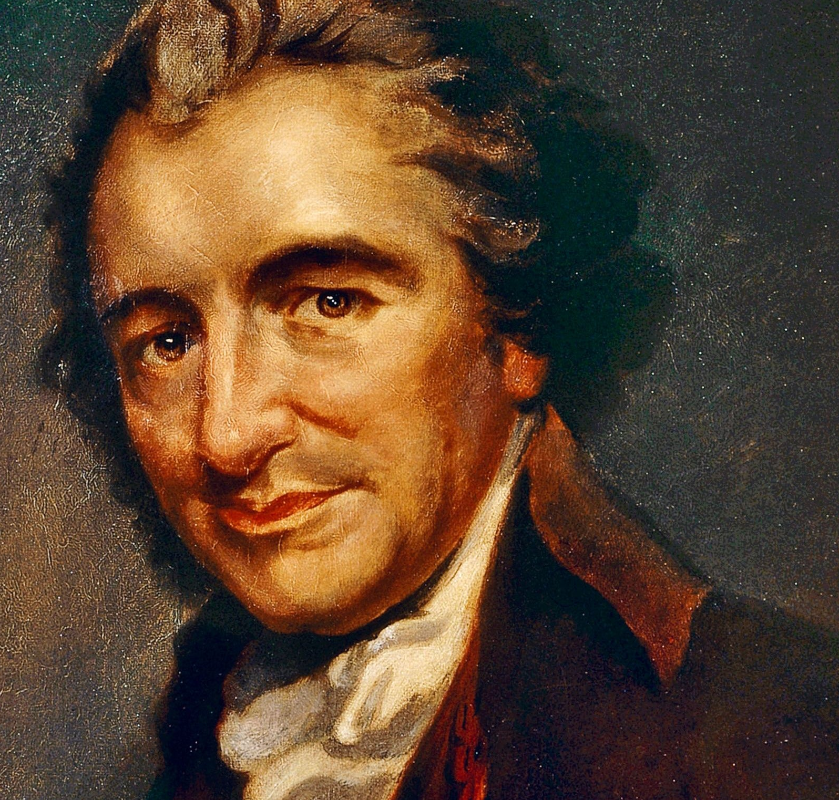
It was a small book called Common Sense written by Thomas Paine which pushed many Americans towards the idea of independence.

Slide 5
Thomas Paine Video

Slide 6
Thomas Paine and
Common Sense
Quiz

